Slide 1
Lessons Learned From the L.A.N.D. Project
L.A.N.D.=Learning, Ability, and Neurological Diversity
Christina Chin-Newman
Sara Smith
Kristina Spink
California State University, East Bay

Slide 2
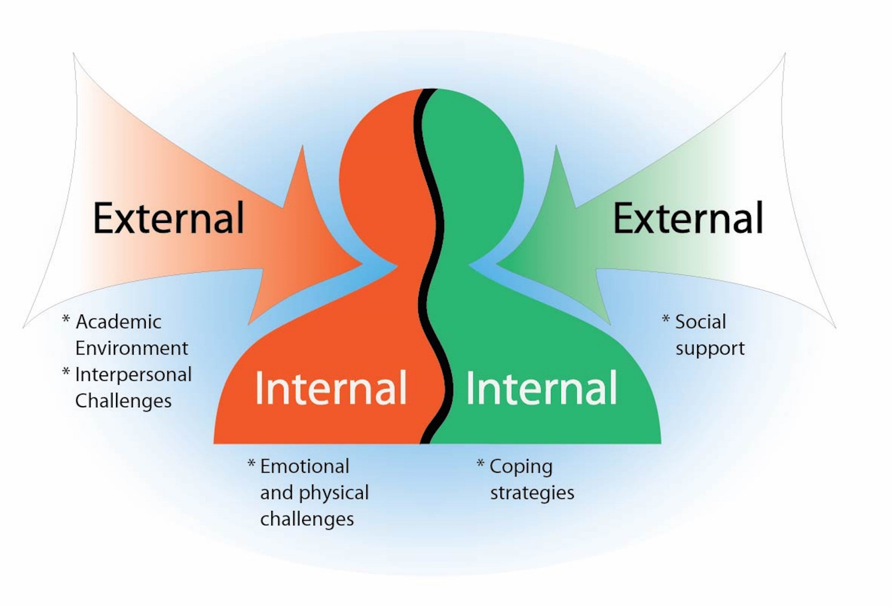
Challenges and Resources

Slide 3
Participants
39 university students with identified learning differences or disabilities
Gender: Female (n=31), Male (n=8)
Age: 19-64 years (mean age= 34)
Ethnic Background:
African American/Black (n=8), Asian/Pacific Islander (n=6), Latino/Hispanic/Mexican (n=5), White/Caucasian/European (n=9), Mixed/Multiracial (n=5), Jewish (n=1), Pakistani (n=1), Not Sure (n=1), Missing (n=2)
Difference Categories:
Many students have overlapping differences: Physical/Sensory/Medical (n=14), Learning Disability (n=10), ADHD (n=9), Mood Disorders (n=7), Anxiety (n=5), PTSD (n=3), Hearing Loss (n=1)
Notes:
(adjust to be 39 participants and exclude focus group maybe

Slide 4
Procedure
Sample Interview Question
“What are the biggest challenges you face as a student with a learning difference or disability?”
Semi-Structured Interviews
In person (n=30)
Phone (n=9)

Slide 5
CHALLENGES
EXTERNAL
Academic Environment
Interpersonal
INTERNAL
Emotional
Health

Slide 6
Academic Environment Challenges
“The truth of the matter is, professor, if you keep your room quiet, I would not be handicapped in here.”
-“Mica”
Classroom distractions (peers eating, perfumes, side chatter)
Issues with test-taking accommodations (noise from surrounding rooms causing distraction, unprofessional proctor behavior)
Ambiguous test questions & original instructor not available in testing room
Forgetting material from previous classes when taking health breaks (sometimes months or years off), slowly finishing degree

Slide 7
Interpersonal Challenges - Professors
“(Professors) need to be approachable… especially when they announce in class to everybody, ‘I don’t want to hear that you’re not feeling well. I don’t want to hear that your mother had to go to the hospital.’ I had one who actually said that, and they did not know that I went through vascular surgery during that class because I would not tell anybody after he made that announcement.”
-“Clare”

Slide 8
Interpersonal Challenges - Professors
Initially finding the nerve to tell professors of accommodations
Feeling unheard by professors who do not respect one’s needs
Professors not understanding student’s challenges, being suspect of student’s need for accommodations
Professors making assumptions about the general student population that may not apply to some differently-abled, presenting material in only one way

Slide 9
Interpersonal Challenges – Students
Keeping up with fellow classmates learning styles & misunderstandings with peers (i.e., timed labs or group activities)
Peers misunderstanding why student receives accommodations
Feeling guilt using accommodations others do not use
Peers (or family) not recognizing or understanding student’s disability or believing it is “real”
Stigmas of being disabled, feeling different, alienated, isolated

Slide 10
Emotional and Health Challenges
“Sometimes people don’t realize the connection between diagnoses and the challenge of learning. When living with, specifically the emotional (issues of my diagnoses), it can interfere with the process. Because my thoughts are not in a direct train, concentration can be a challenge and it takes extra energy to stay focused and to deal with the challenges of school itself that come along with it. Even something as simple as recording (a lecture) and listening and comprehending, and remembering (it) all at the same time can be a challenge some days. Being nutritionally prepared, having slept properly… all those things are issues for people living with my challenges, and they affect my ability to learn.”
– “Wes”

Slide 11
Emotional Challenges
Stress clouding thinking
Anxiety detouring focus
Mood changes that affect motivation
Burdensome family issues
Not “passing” as normal
Getting over the stereotypes of being less capable than other students

Slide 12
Health Challenges
Dependency on medication (or worry of it occurring)
Issues with transportation to campus with health issues (unable to drive on medications, accessibility on public transportation)
Troubles maneuvering around campus and the time it consumes
Missing or inappropriately placed accessibility furniture

Slide 13
RESOURCES
EXTERNAL
Social Support
INTERNAL
Coping Strategies

Slide 14
Social Support – Faculty & Staff
“That emotional connection (with the professor) is helpful because it is an emotional disability.”
– “Raquel”
Professors: Office hours & specialized tutoring sessions, connecting emotionally (learning students’ names, empathizing), encouraging conversation between students in class
Other University Staff: (such as tutors, advisors, counselors) take a personal approach, are accountable (answer e-mails quickly, provide accurate information), go out of their way to find resources

Slide 15
Social Support – Peers
“Friends have helped me in my classes…. They might not necessarily have the same disabilities that I have, but the challenge so far of balancing our lives and meeting the challenges with content, it is the same, and the stress created by it all. So being able to download and talk to someone about those things has been extremely helpful.”
– “Wes”
Fellow Students: organized study groups, friendly competition
Peers with Differences: listening & understanding one’s perspective, feeling accepted, regular group therapy
Friends: listening, helping to de-stress & to see the big picture

Slide 16
Social Support – Family
“Definitely my mom (is a big support) because, especially when I get confused or overwhelmed by everything, I can call and talk to her. She reminds me of the things she taught me that I sometimes forget. Like (she) asks me if I’ve been sleeping right or exercising, eating right, those sorts of things.”
– “Neil”
Listening, encouraging, boosting self esteem
Help develop tools and strategies
Study help, transportation

Slide 17
Coping Strategies
“What really helps in class is I focus in on my breathing when I start going off. That helps with the ADD and the bipolar, especially in class. Because sometimes I start going off in class like just shit starts getting really crazy and I'm like, ‘all right, bring yourself back, you're starting to go over that edge, you don't need to go over that edge, ‘cause you know what happens,’ and then it all stops.”
-“Neil”

Slide 18
Coping Strategies
Environmental: Find the best study space, block out distractions mentally (headphones, closing eyes during lectures, focused breaths, etc.)
Proactive steps: Establish clear goals for each step of the way, keep a to-do journal, before quarter begins visit classroom locations, organizing study materials & a study schedule, & meet with new professors, establish good professor relationships, go out of comfort zone, intentionally seek peer friendships, use campus resources (AS, tutoring, school website), speak up to professors when falling behind, report unprofessional professors, self advocate, request extra assignment time
Study techniques: Multiple textbook reviews, record & listen regularly to lectures, teach new material to others, orally discuss concepts with professors
Physical & Emotional Health: Sleep & eat well, regularly exercise, find religious or other social support

Slide 19
Challenges and Resources

Slide 20
Thank you!
ACKNOWLEDGMENTS
Dr. Sara Smith
Dr. Alina Engelman
Dr. Katie Brown
Livier Ayon
Patricia Finnegan
Suzy kain
DJ nair
Sonam Bhuptani

